Slide 1
Gender Detection using VGG Net
Team 14
Mihir Joshi
Narendra Katamaneni
Akshitha Duddala
Saakshi

Slide 2
Introduction
Gender Classification was first perceived as a study in psychophysical studies.
It focusses on understanding human visual processing and identifying key features used to categorize between male and female and this is the basis for our classification
Face recognition applications are widely used in Biometrics, Human Computer interactions and computer vision
Convolutional Neural network has been used for real time gender classification based on Facial images

Slide 3
Conventional Approach For Pattern Recognition
Conventional approach involves stages of image acquisition and processing, dimensionality reduction, feature extraction, and classification, in that order.
Prior knowledge of the application domain is required to determine the best feature extractor to design.
The performance of the recognition system is highly dependent on the type of classifier chosen, which is in turn dependent on the feature extraction method applied
Any changes to the problem domain require a complete redesign of the system

Slide 4
Convolutional Neural Network Approach
The convolutional neural network (CNN) consists of several convolutional layers alternating with subsampling layers and ends with one or more fully connected layers in the standard multilayer perceptron (MLP).
A significant advantage of the CNN over conventional approaches in pattern recognition is its ability to simultaneously extract features, reduce data dimensionality, and classify in one network structure
Feature extraction and classification are performed within a single network structure through learning on data samples
Feature selection is also integrated into the training process by learning the weights held responsible for extracting features
Minimal preprocessing Required
Relatively easier to train since they have fewer parameters than fully connected MLP neural networks with the same number of hidden layers.

Slide 5
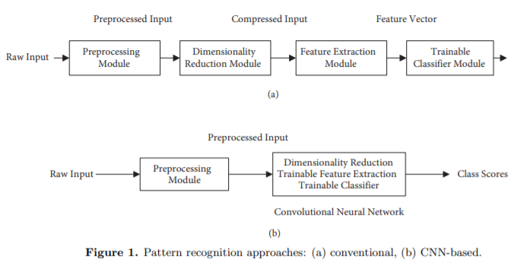
Pattern Recognition Approaches

Slide 6
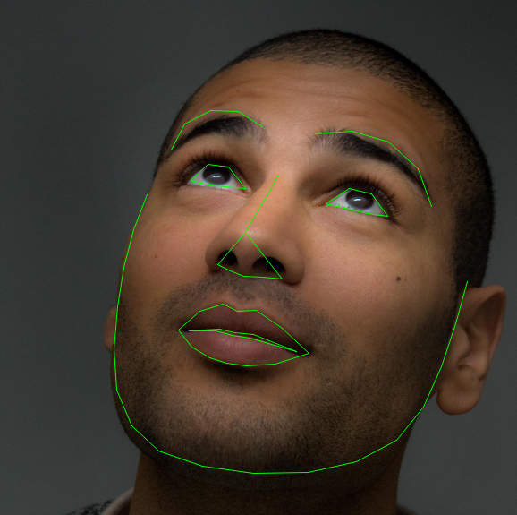
Facial Landmarks
Detecting facial landmarks is a two-step process:
Step #1: Localize the face in the image.
Step #2: Detect the key facial structures on the face ROI
Key facial structures:
Mouth
Right eyebrow
Left eyebrow
Right eye
Left eye
Nose
Jaw

Slide 7
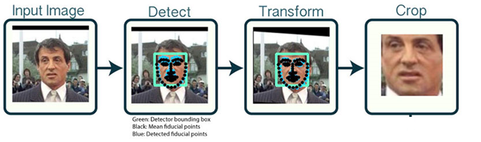
Architecture For Face Detection

Slide 8


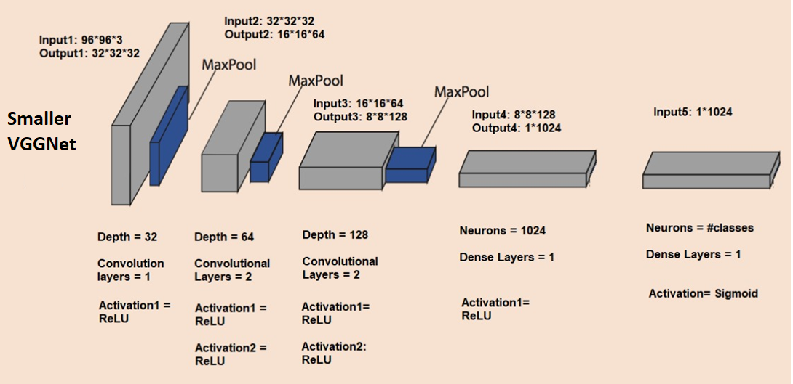



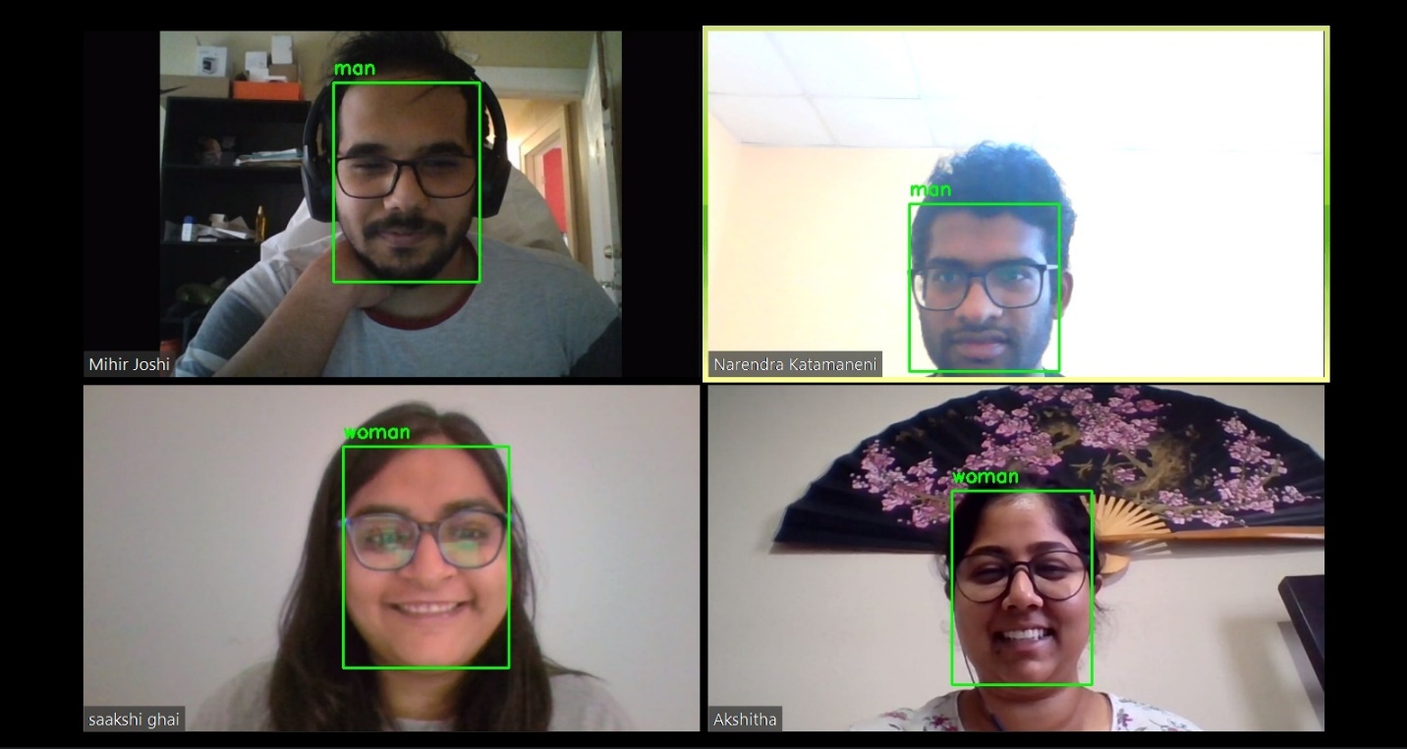
Architecture For Gender Detection
Face Detector

Slide 9
CNN For Gender Detection

Slide 10
Preprocessing
Needed to ensure the compatibility of the data size with that of the trained model
Identification of corner points of the rectangle using cv2lib
Rectangle is drawn using cv2lib
We used numpy library to crop the rectangle by copying the pixel value in the rectangle into a matrix
Resize the image
Converting pixel value from 0-255 to a range to 0-1

Slide 11
Python Packages
numpy
opencv-python
tensorflow
Keras
Scikit learn
matplotlib
requests
progressbar
cvlib

Slide 12


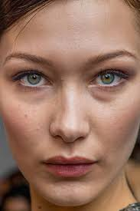

Training
The Keras model is created by training SmallerVGGNet from scratch on around 4200 images (Approximately 2000 for each gender)
Face region is cropped by applying Face Detection using cvlib on images gathered from Google Images

Slide 13
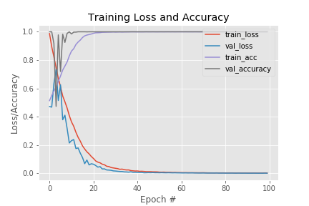
Overfitting
Added 2 convolutional layers of 256 depth
Learning rate : 1e-4
Epochs : 100
Train accuracy : 100%
Validation accuracy : ~98%

Slide 14
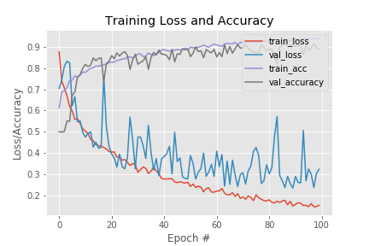
Optimal Hyperparameters
Training dataset size : 80%
Validation dataset size : 20%
Learning rate : 1e-4
Epochs : 100
Train accuracy : 94%
Validation accuracy : ~88%

Slide 15
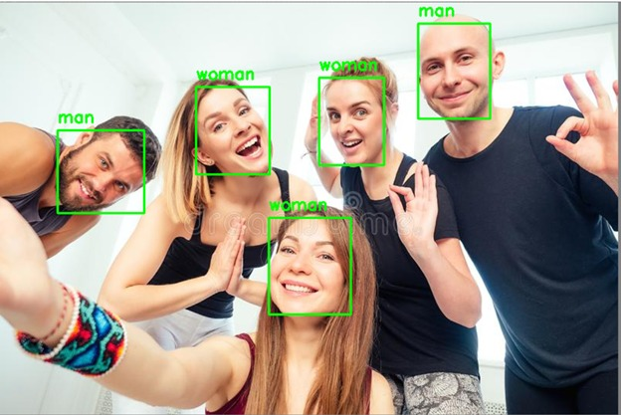
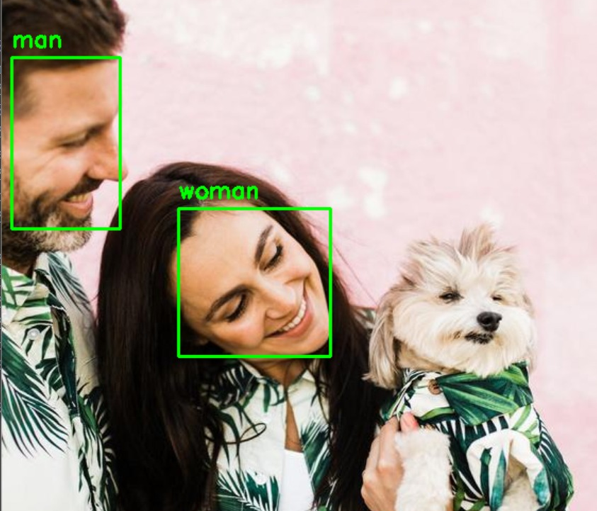
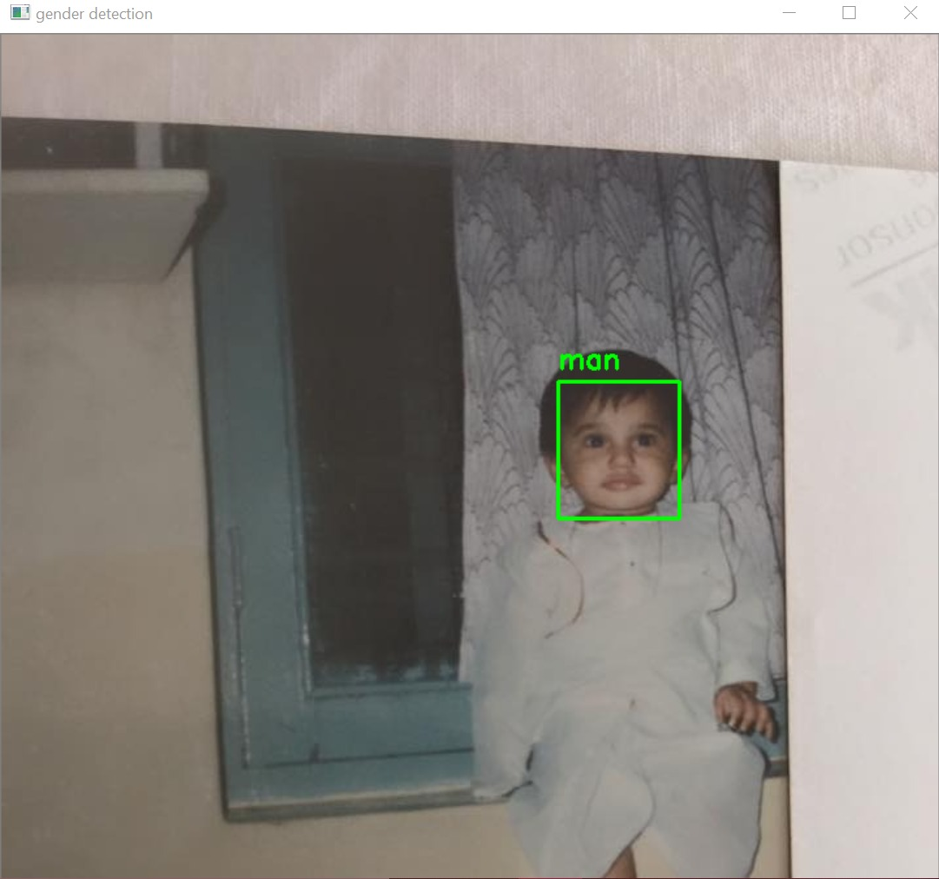
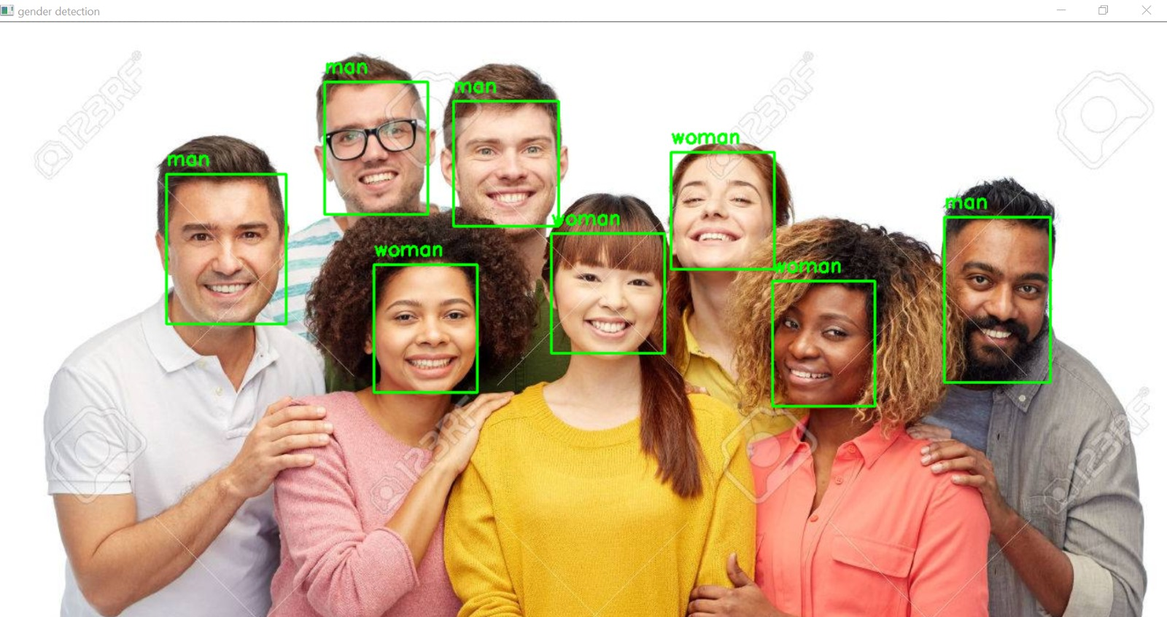
Results

Slide 16
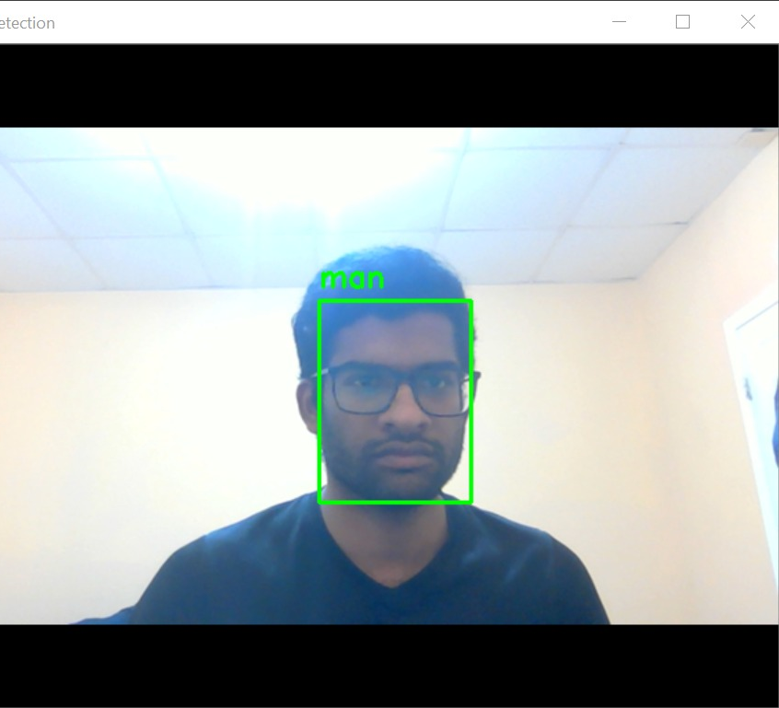
Facial Recognition Using webcam
While webcam remains on, we are capturing and extracting every frame which is given as input to our model

Slide 17
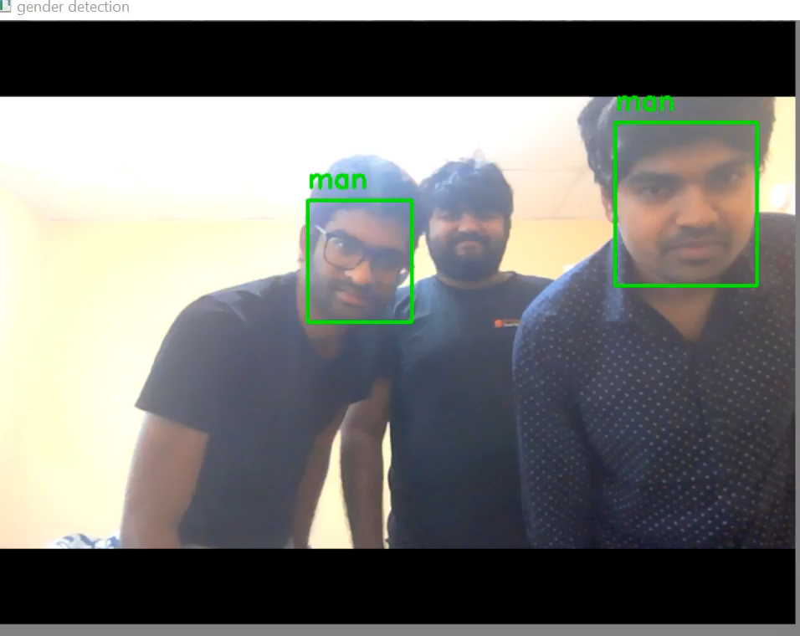
Result From The Webcam

Slide 18
Complications
There was a lot of variations in females with or without makeup or with different kinds of religious headgear(hijab)
Unsure of faces without sharp facial features
To overcome these difficulties we had to train the dataset over large number of images (approximately 4000)
We also cropped the images to include only the part from the forehead

Slide 19
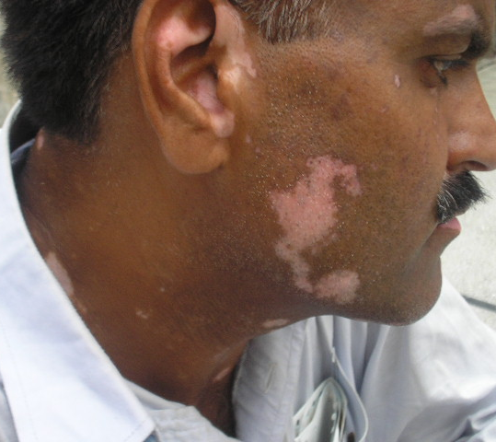
Future Scope Of The Model
This can be used for the diagnoses of diseases whose symptoms can be detected through their faces
Instead of tags being man and woman, the tags would be healthy skin and diseased skin
Various classifications of diseases can be made by expanding it to various skin diseases and change the sigmoid activator into a softmax

Slide 20
Thank You!

